Slide 1
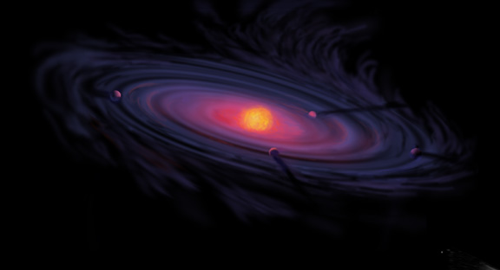
Origins of Gas Giant Compositions: The Role of Disk Location and Dynamics
Ana-Maria Piso
Thesis Colloquium: April 27th, 2016

Slide 2

Acknowledgments

Slide 3
Acknowledgments

Slide 4
Acknowledgments
Karin Öberg

Slide 5
Acknowledgments
Karin Öberg
Ruth Murray-Clay

Slide 6
Acknowledgments
Karin Öberg
Ruth Murray-Clay
Rosanne Di Stefano

Slide 7
Acknowledgments
Karin Öberg
Ruth Murray-Clay
Rosanne Di Stefano
Til Birnstiel, Jamila Pegues, Andrew Youdin

Slide 8
Acknowledgments
Karin Öberg
Ruth Murray-Clay
Rosanne Di Stefano
Til Birnstiel, Jamila Pegues, Andrew Youdin
Dimitar Sasselov, Matt Holman, Sean Andrews, Fred Ciesla

Slide 9
Acknowledgments
Karin Öberg
Ruth Murray-Clay
Rosanne Di Stefano
Til Birnstiel, Jamila Pegues, Andrew Youdin
Dimitar Sasselov, Matt Holman, Sean Andrews, Fred Ciesla
Xuening Bai, Jenny Bergner, Ilse Cleeves, Ian Czekala, Edith Fayolle, Dawn Graninger, Viviana Guzman, Jane Huang, Ryan Loomis, Meredith MacGregor, Chris Merchantz, Charlie Qi, Mahesh Rajappan, Luca Ricci, Anjali Tripathi, David Wilner

Slide 10
Acknowledgments
Karin Öberg
Ruth Murray-Clay
Rosanne Di Stefano
Til Birnstiel, Jamila Pegues, Andrew Youdin
Dimitar Sasselov, Matt Holman, Sean Andrews, Fred Ciesla
Xuening Bai, Jenny Bergner, Ilse Cleeves, Ian Czekala, Edith Fayolle, Dawn Graninger, Viviana Guzman, Jane Huang, Ryan Loomis, Meredith MacGregor, Chris Merchantz, Charlie Qi, Mahesh Rajappan, Luca Ricci, Anjali Tripathi, David Wilner
Courtney Dressing, Bekki Dawson

Slide 11
Acknowledgments
Karin Öberg
Ruth Murray-Clay
Rosanne Di Stefano
Til Birnstiel, Jamila Pegues, Andrew Youdin
Dimitar Sasselov, Matt Holman, Sean Andrews, Fred Ciesla
Xuening Bai, Jenny Bergner, Ilse Cleeves, Ian Czekala, Edith Fayolle, Dawn Graninger, Viviana Guzman, Jane Huang, Ryan Loomis, Meredith MacGregor, Chris Merchantz, Charlie Qi, Mahesh Rajappan, Luca Ricci, Anjali Tripathi, David Wilner
Courtney Dressing, Bekki Dawson
Peg Herlihy, Robb Scholten

Slide 12
Acknowledgments
Karin Öberg
Ruth Murray-Clay
Rosanne Di Stefano
Til Birnstiel, Jamila Pegues, Andrew Youdin
Dimitar Sasselov, Matt Holman, Sean Andrews, Fred Ciesla
Xuening Bai, Jenny Bergner, Ilse Cleeves, Ian Czekala, Edith Fayolle, Dawn Graninger, Viviana Guzman, Jane Huang, Ryan Loomis, Meredith MacGregor, Chris Merchantz, Charlie Qi, Mahesh Rajappan, Luca Ricci, Anjali Tripathi, David Wilner
Courtney Dressing, Bekki Dawson
Peg Herlihy, Robb Scholten
ALL the wonderful grad students!

Slide 13
Acknowledgments
Karin Öberg
Ruth Murray-Clay
Rosanne Di Stefano
Til Birnstiel, Jamila Pegues, Andrew Youdin
Dimitar Sasselov, Matt Holman, Sean Andrews, Fred Ciesla
Xuening Bai, Jenny Bergner, Ilse Cleeves, Ian Czekala, Edith Fayolle, Dawn Graninger, Viviana Guzman, Jane Huang, Ryan Loomis, Meredith MacGregor, Chris Merchantz, Charlie Qi, Mahesh Rajappan, Luca Ricci, Anjali Tripathi, David Wilner
Courtney Dressing, Bekki Dawson
Peg Herlihy, Robb Scholten
ALL the wonderful grad students!
Adriana, Andra, Carlo, C.S., Herman, Ignat, Irina, Iulia, John, Laura, Luly, Monica, Rachel, Simona, Tom, …

Slide 14
Acknowledgments
Karin Öberg
Ruth Murray-Clay
Rosanne Di Stefano
Til Birnstiel, Jamila Pegues, Andrew Youdin
Dimitar Sasselov, Matt Holman, Sean Andrews, Fred Ciesla
Xuening Bai, Jenny Bergner, Ilse Cleeves, Ian Czekala, Edith Fayolle, Dawn Graninger, Viviana Guzman, Jane Huang, Ryan Loomis, Meredith MacGregor, Chris Merchantz, Charlie Qi, Mahesh Rajappan, Luca Ricci, Anjali Tripathi, David Wilner
Courtney Dressing, Bekki Dawson
Peg Herlihy, Robb Scholten
ALL the wonderful grad students!
Adriana, Andra, Carlo, C.S., Herman, Ignat, Irina, Iulia, John, Laura, Luly, Monica, Rachel, Simona, Tom, …
My family

Slide 15
Fundamental Questions
Where in the disk can giant planets form?
What compositions will the formed giant planets have obtained?

Slide 16
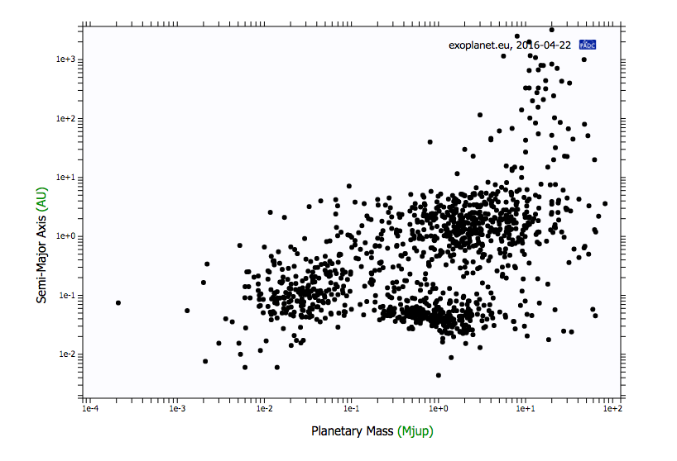
exoplanet.eu

Slide 17
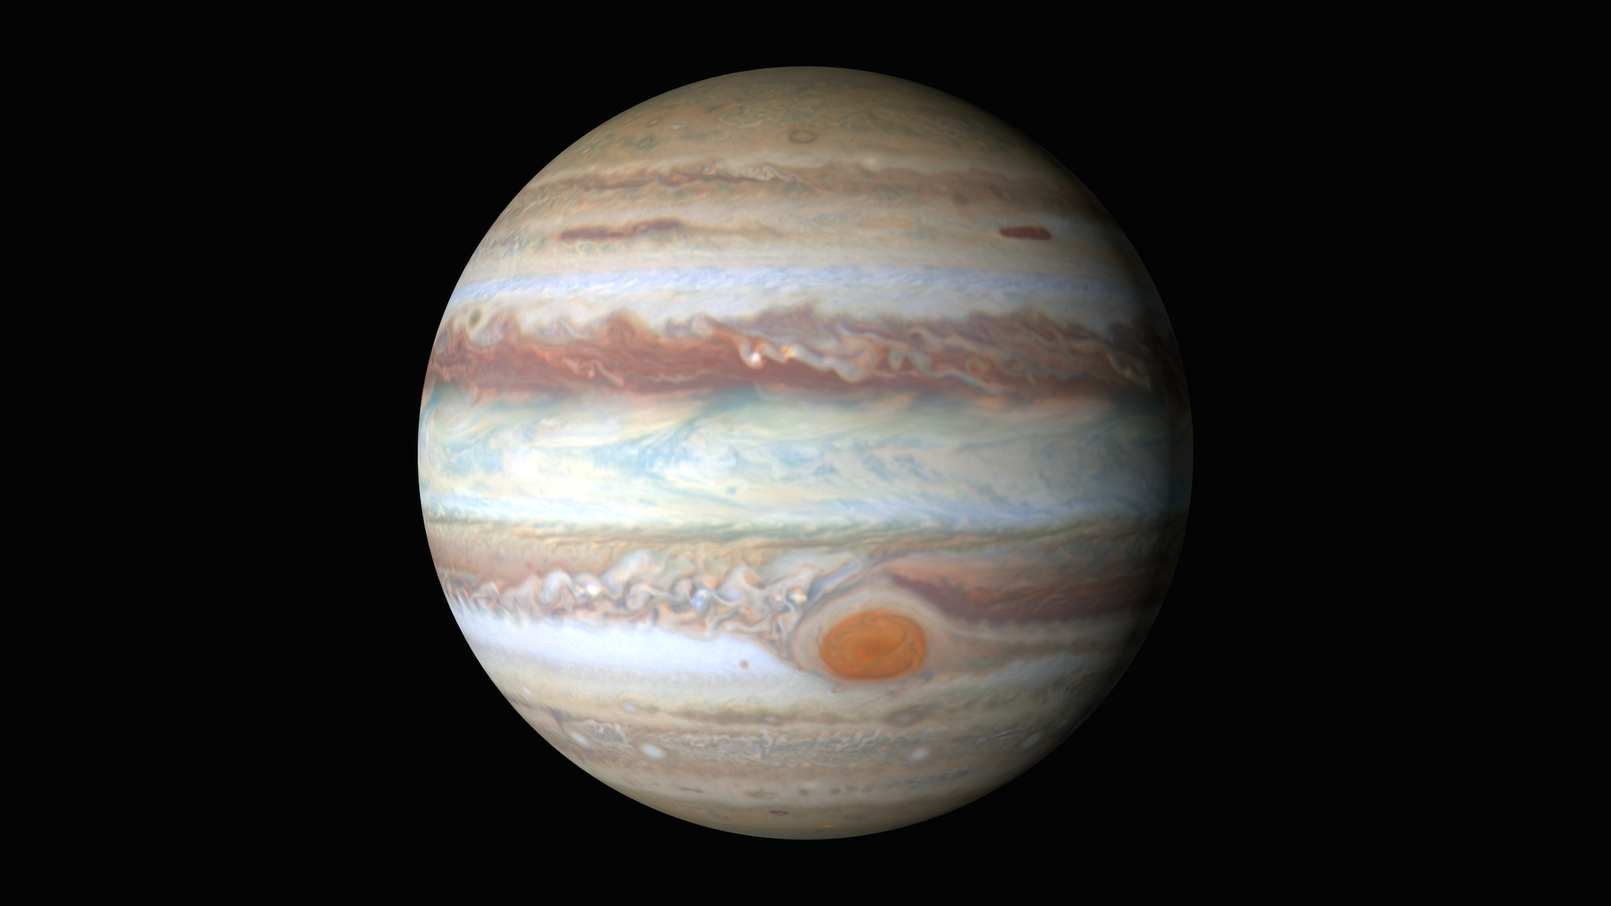
Gas Giants
Notes:
Picture of e.g. Jupiter and discuss why gas giants are important, and why we preferentially look at giant planets atmospheric spectra; there are also more problematic to form

Slide 18
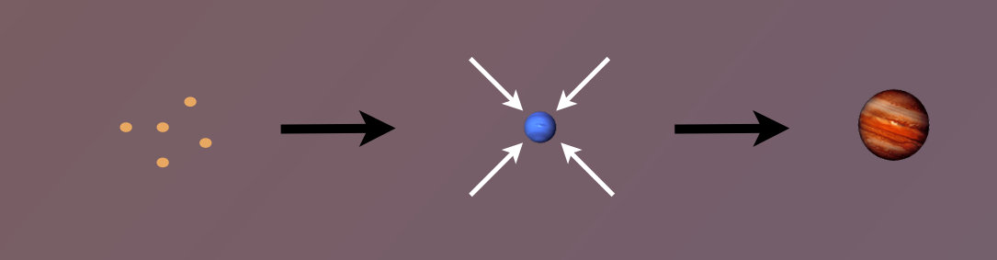
Disk-Planet Connection
The composition of planets is determined by and tightly linked to the disk composition

Slide 19
Thesis Structure
The role of disk location in the formation of wide separation gas giants (Piso et al. 2014, 2015a)
The effect of disk structure and composition at different radii on the eventual composition of giant planets (Piso et al. 2015b, Piso et al. 2016)

Slide 20
Thesis Structure
The role of disk location in the formation of wide separation gas giants (Piso et al. 2014, 2015a)
The effect of disk structure and composition at different radii on the eventual composition of giant planets (Piso et al. 2015b, Piso et al. 2016)

Slide 21
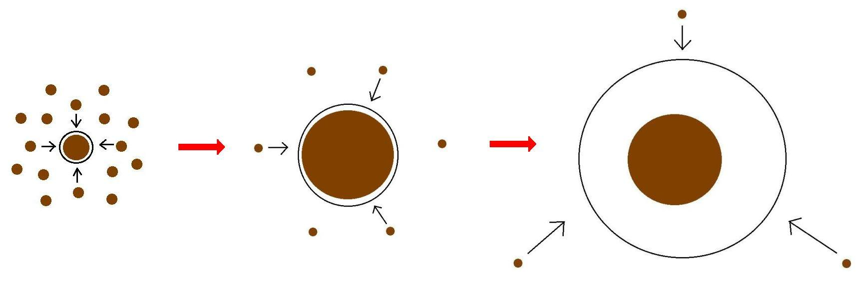
Minimum Core Masses for Giant Planet Formation

Slide 22
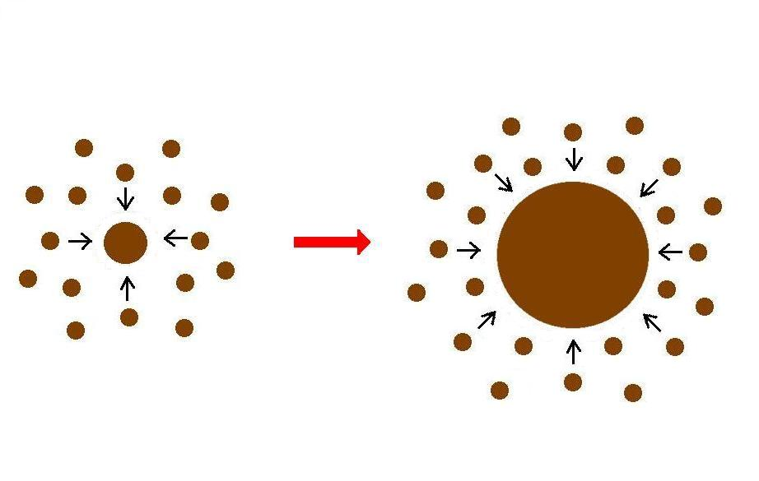
Giant planet formation requires fast core growth

Slide 23
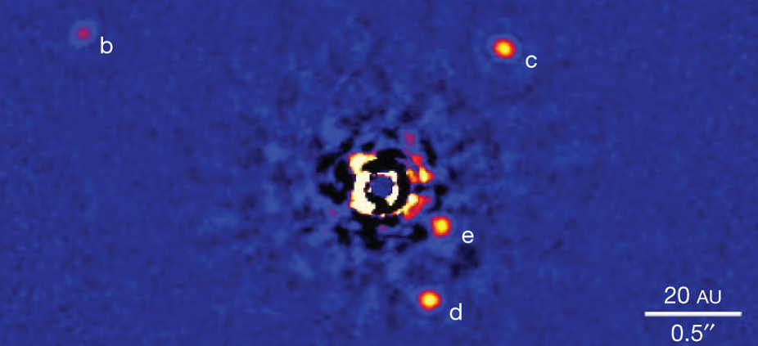
Marois+2010

Slide 24
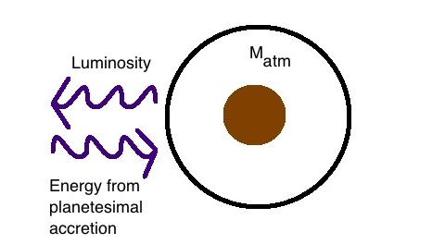
Core Accretion at high planetesimal accretion rates yields steady state
=> M_{atm} is a function of M_{core}
M_{core}

Slide 25

High planetesimal accretion
ONE M_{atm} for each M_{core}
=> ONE core mass for which M_{atm} ~ M_{core} = “critical core mass”
M_{atm,2}
M_{atm,1}
M_{core,1}
M_{core,2}

Slide 26
Planetesimal accretion is not constant at a given location throughout disk life
e.g., Pollack+96, Ikoma+00
M_{atm} << M_{core}
HIGH dM_{core}/dt
M_{atm} << M_{core}
dM_{core}/dt goes down
M_{atm} ≤ M_{core}
LOW dM_{core}/dt

Slide 27
Planetesimal accretion is not constant at a given location throughout disk life
e.g., Pollack+96, Ikoma+00
M_{atm} << M_{core}
HIGH dM_{core}/dt
M_{atm} << M_{core}
dM_{core}/dt goes down
M_{atm} ≤ M_{core}
LOW dM_{core}/dt

Slide 28
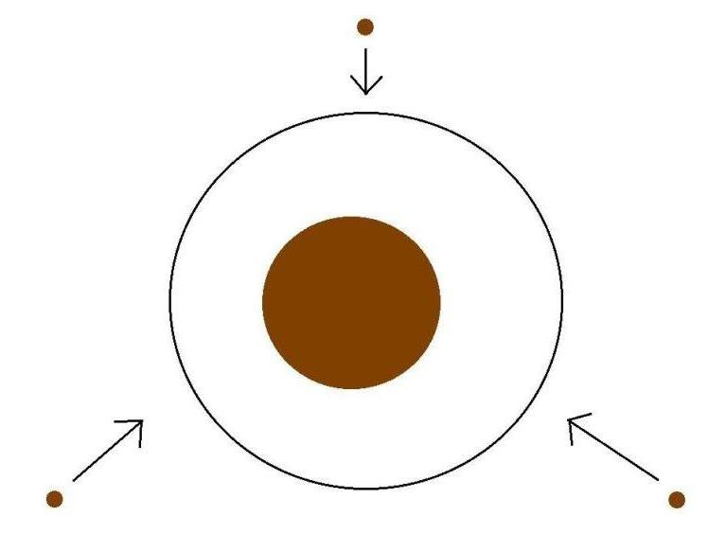
Low planetesimal accretion regime
Atmospheric evolution dominated by
Kelvin-Helmholtz contraction
M_{atm}
M_{core}
M_{atm} ≤ M_{core}
LOW dM_{core}/dt

Slide 29
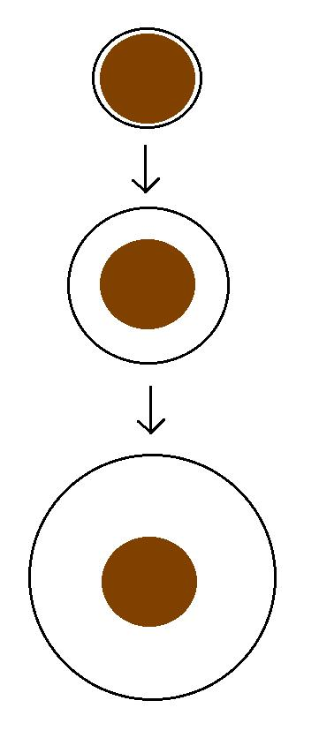
Kelvin-Helmholtz contraction
M_{atm} is a function of time
=> EVERY core can have
M_{atm} ~ M_{core}
“critical core mass”
M_{crit} = M_{core} for which
M_{atm}(t_{disk}) ~ M_{core}
M_{atm}(t₁)
M_{core}
M_{atm}(t₂)
M_{core}
M_{atm}(t₃) ~ M_{core}
M_{core}

Slide 30
GOAL
Determine the minimum core mass, M_{crit}, to form a giant planet during the disk lifetime in the low planetesimal accretion regime when atmosphere dominated by KH contraction
Calculate M_{crit} with
REALISTIC EQUATION OF STATE (EOS)
REALISTIC DUST OPACITIES

Slide 31
Model Assumptions
Negligible planetesimal accretion => solid core of fixed mass M_{c}
Atmosphere is embedded in the gas disk, spherically symmetric and in hydrostatic balance
Two layer atmosphere: inner convective region and outer radiative region
Constant luminosity throughout the radiative region
see Piso & Youdin (2014) for details

Slide 32
Static profiles connected by global cooling equation
CONVECTIVE
RADIATIVE
L ~ -dE/dt
a = 10 AU, M_{c} = 5 M_{E}
Adiabatic gradient relates P, T, rho => determines atmospheric profile and parametrizes EOS
a = 10 AU, M_{c} = 5 M_{E}

Slide 33
Atmospheric evolution and M_{crit} are highly dependent on
EQUATION OF STATE
DUST OPACITY

Slide 34
Atmospheric evolution and M_{crit} are highly dependent on
EQUATION OF STATE
DUST OPACITY

Slide 35
Adiabatic gradient is variable for realistic EOS
Piso, Youdin, & Murray-Clay (2015)

Slide 36
Adiabatic gradient is variable for realistic EOS
Saumon+95
Piso, Youdin, & Murray-Clay (2015)
Our extension

Slide 37
Adiabatic gradient is variable for realistic EOS
Piso, Youdin, & Murray-Clay (2015)
H2 dissociation
H ionization
Ideal gas

Slide 38
Adiabatic gradient is variable for realistic EOS
Piso, Youdin, & Murray-Clay (2015)
Partially excited H₂ rotational states

Slide 39
Adiabatic gradient is variable for realistic EOS
H₂ spin isomers ORTHOHYDROGEN and PARAHYDROGEN can be in thermal equilibrium or fixed ratio
Piso, Youdin, & Murray-Clay (2015)
Ortho-para equilibrium
Fixed 3:1 ortho-to-para ratio
Partially excited H₂ rotational states

Slide 40
Variations in due to non-ideal EOS effects INCREASE M_{crit}
ad
t_disk ~ 3 Myr, ISM opacity
Piso, Youdin, & Murray-Clay (2015)

Slide 41
Atmospheric evolution and M_{crit} are highly dependent on
EQUATION OF STATE
DUST OPACITY

Slide 42
Atmospheric evolution and M_{crit} are highly dependent on
EQUATION OF STATE
DUST OPACITY

Slide 43
Grain growth opacity DECREASES M_{crit}
dN/ds ~ s^{-p}
p = 3.5
s_{max} = 1 cm
t_disk ~ 3 Myr, realistic EOS
t_disk ~ 3 Myr, realistic EOS
Piso, Youdin, & Murray-Clay (2015)
Piso, Youdin, & Murray-Clay (2015)

Slide 44
Grain growth opacity DECREASES M_{crit}
dN/ds ~ s^{-p}
p = 3.5
s_{max} = 1 cm
M_{crit}:
~8 M_{E} @ 5 AU
~5 M_{E} @ 100 AU
t_disk ~ 3 Myr, realistic EOS
Piso, Youdin, & Murray-Clay (2015)

Slide 45
Grain growth opacity DECREASES M_{crit}
dN/ds ~ s^{-p}
p = 3.5
s_{max} = 1 cm
M_{crit}:
~8 M_{E} @ 5 AU
~5 M_{E} @ 100 AU
coagulation (p = 2.5)
t_disk ~ 3 Myr, realistic EOS
Piso, Youdin, & Murray-Clay (2015)

Slide 46
Takeaway point 1: M_{crit} is highly dependent on disk location and properties, and may be as low as 1 M_{E}
Marois+2010

Slide 47
Disk Compositions Regulate Planet Compositions
The composition of planets is determined by and tightly linked to the disk composition

Slide 48
Thesis Structure
The role of disk location in the formation of wide separation gas giants (Piso et al. 2014, 2015a)
The effect of disk structure and composition at different radii on the eventual composition of giant planets (Piso et al. 2015b, Piso et al. 2016)

Slide 49
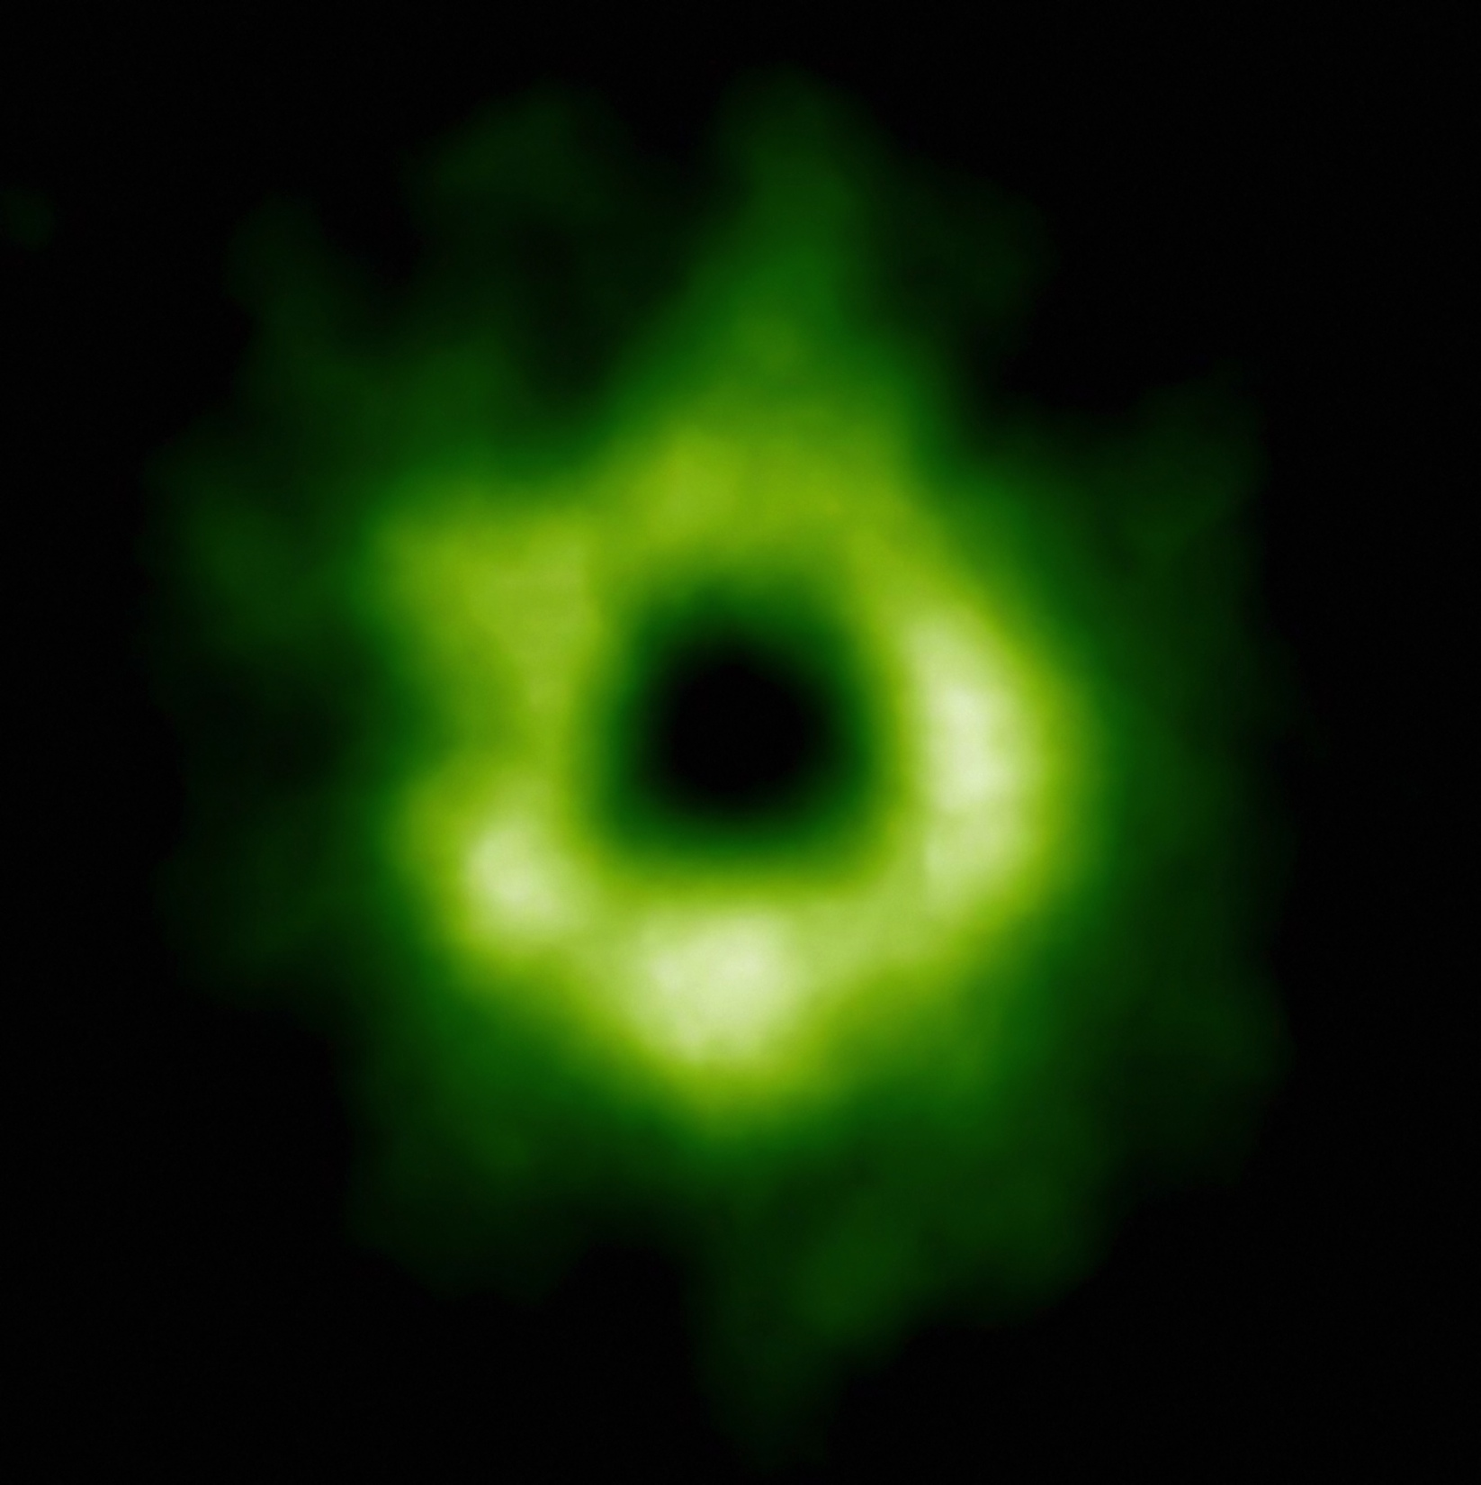
Snowline Locations in Protoplanetary Disks and C/N/O ratios
Notes:
Put the green TWHya figure instead.

Slide 50
BASIC IDEA
Understand the disk well enough to:
Predict what kind of planet compositions result from planet formation in different parts of the disk
Back-track the planet formation location based on the planet composition

Slide 51
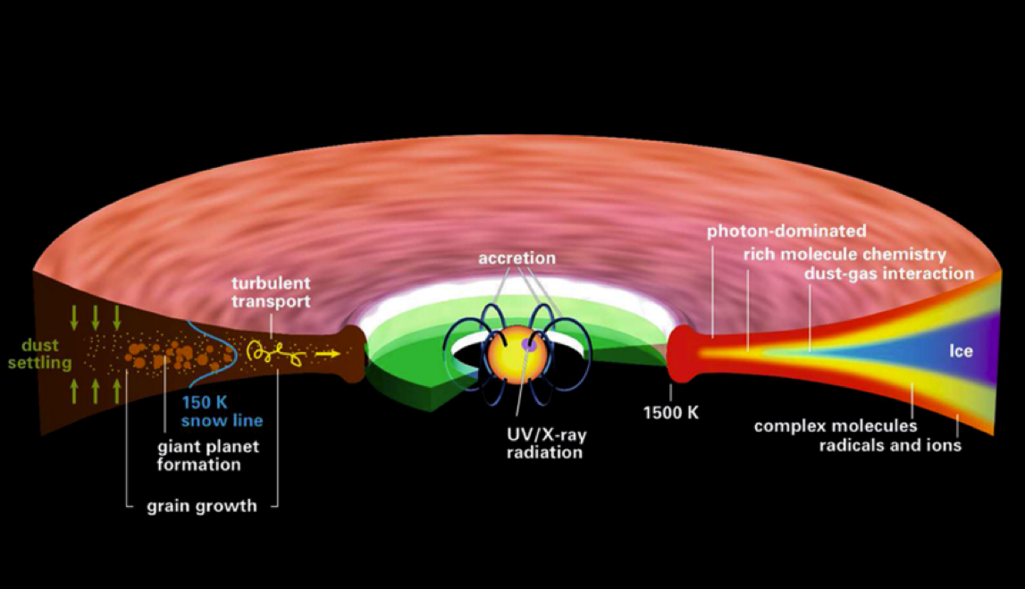
Disk structure is complex!
Henning&Semenov (2013)
Notes:
Remove the while and make the figure bigger.

Slide 52
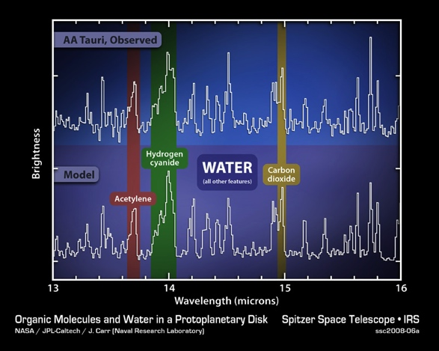
Volatile compounds have been detected in protoplanetary disks
Oberg+11
Notes:
Replace with spitzer water in disks spectrum image and DCO+ image.

Slide 53
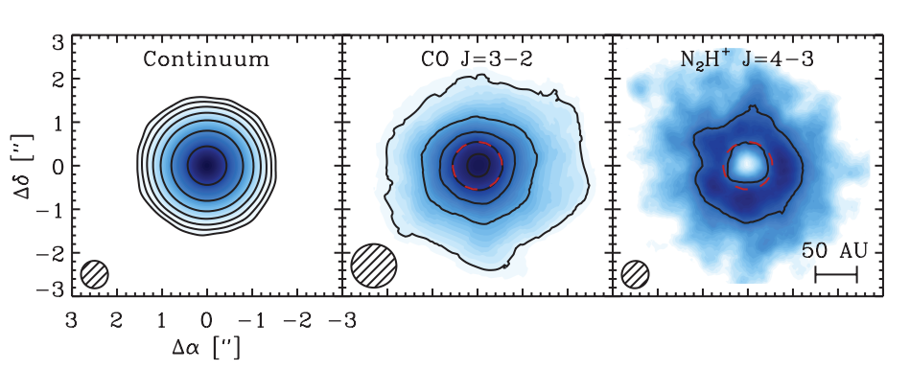
Snowlines of volatile molecules have been detected in disks
Qi+13

Slide 54
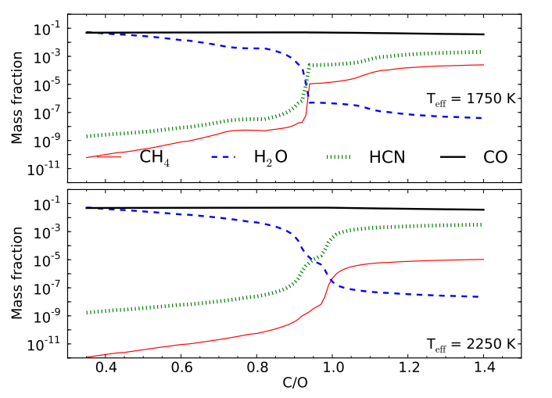
C/O ratio is an important signature of atmospheric chemistry
Molliere+15

Slide 55
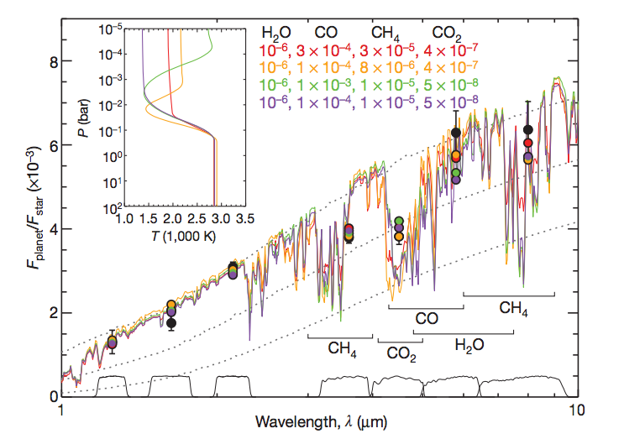
Some giant planets may have C/O ratios different from the stellar value of 0.54
Madhusudhan+11
Notes:
Show a slide before this with model predictions. Arxiv paper by katherine lodders.2009 figure 1.8

Slide 56
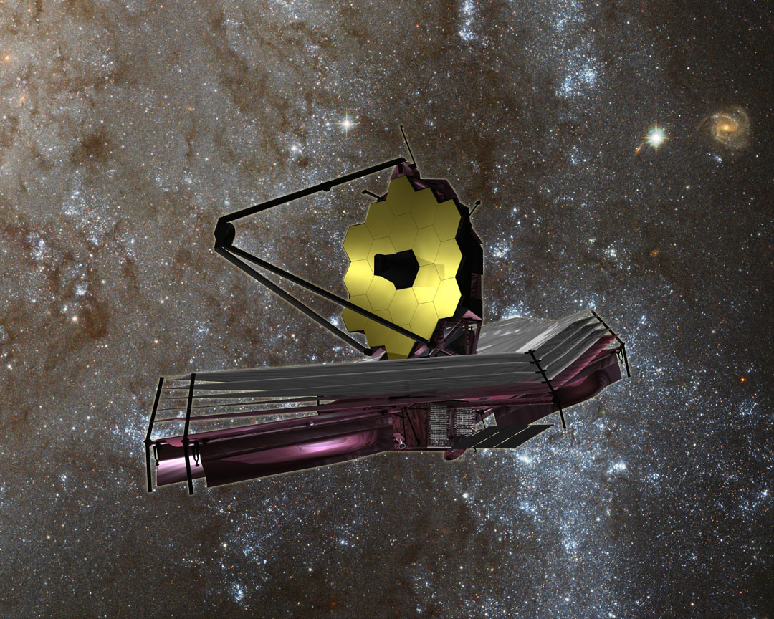

Slide 57
WHY Different C/O Ratios?
Possible explanation: main carriers of C and O, i.e. H₂O, CO₂ and CO, have different condensation temperatures => variations in the abundances of C and O in solids and gas between the snow lines of these volatiles

Slide 58
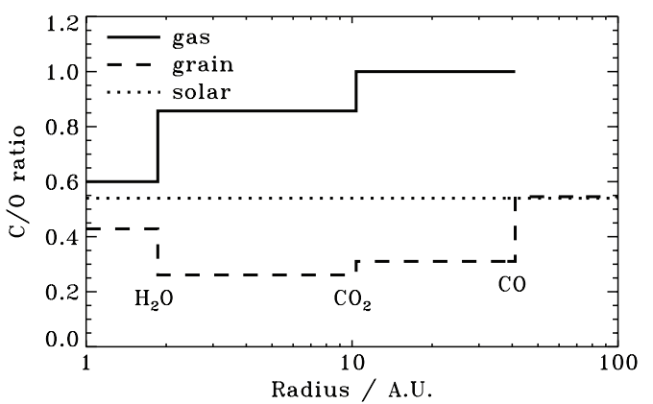
Oberg+11
After Oberg+11

Slide 59
Understand how radial drift, gas accretion and ice morphology affect snowline locations, and thus the C/O ratio in gas and dust throughout the disk
GOAL

Slide 60
Radial drift of solids
Gas moves at sub-Keplerian velocity:
v_{gas} ~ v_{K} (1-c_{s}² / v_{k}²)
Small particles (~micron size) move with the gas
Large particles (~km size) are unaffected by gas drag
“Intermediate sized” particles (~cm-m size) experience a headwind and drift towards the star

Slide 61
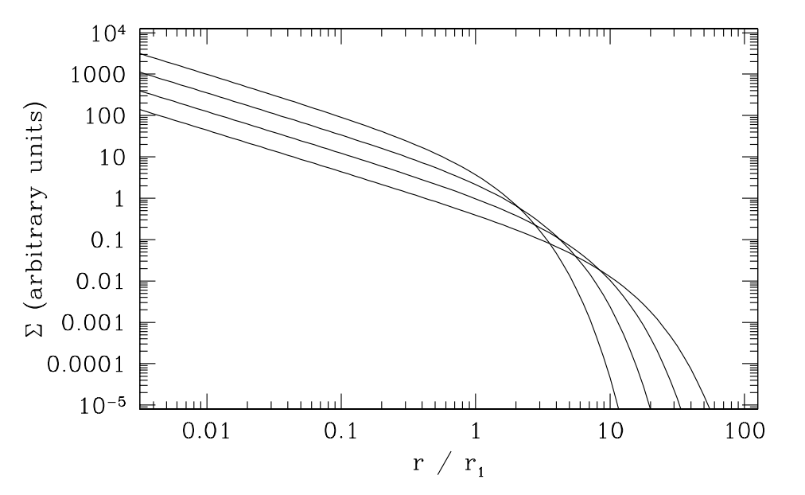
Gas disk accretes onto the central star
alpha-disk prescription: ν = α c_{s} H
Armitage 2009

Slide 62
Timescales for desorption, radial drift and gas accretion ARE comparable
Piso, Oberg, Birnstiel, Murray-Clay (2015)

Slide 63
We determined upper limits for the C/O ratio across the disk
Piso, Oberg, Birnstiel, Murray-Clay (2015)

Slide 64
Ice Morphology
The binding energies of CO varies by a factor of ~1.7 depending on whether CO is pure or water dominated ice
Credit: Edith Fayolle

Slide 65
Disk dynamics and ice morphology may change the CO snowline location by a factor of 7!
Piso, Oberg, Pegues (2016, in prep)
Notes:
Split in 2 slides; talk about N/O, then next slide say the same holds true for C/O

Slide 66
Disk dynamics and ice morphology may change the CO snowline location by a factor of 7!
H₂O
CO₂
CO
Piso, Oberg, Pegues (2016, in prep)
Notes:
Split in 2 slides; talk about N/O, then next slide say the same holds true for C/O

Slide 67
Disk dynamics and ice morphology may change the CO snowline location by a factor of 7!
H₂O
CO₂
CO
Disk dynamics
=> factor of ~2
Piso, Oberg, Pegues (2016, in prep)
Notes:
Split in 2 slides; talk about N/O, then next slide say the same holds true for C/O

Slide 68
Disk dynamics and ice morphology may change the CO snowline location by a factor of 7!
H₂O
CO₂
CO
Disk dynamics
=> factor of ~2
Ice morphology
=> factor of ~3-4
Piso, Oberg, Pegues (2016, in prep)
Notes:
Split in 2 slides; talk about N/O, then next slide say the same holds true for C/O

Slide 69
Disk dynamics and ice morphology may change the CO snowline location by a factor of 7!
H₂O
CO₂
CO
Disk dynamics
=> factor of ~2
Ice morphology
=> factor of ~3-4
CO snowlines span 9-61 AU!
Piso, Oberg, Pegues (2016, in prep)
Notes:
Split in 2 slides; talk about N/O, then next slide say the same holds true for C/O

Slide 70
More volatile snowlines in disks
Piso, Pegues, Oberg (2016)

Slide 71
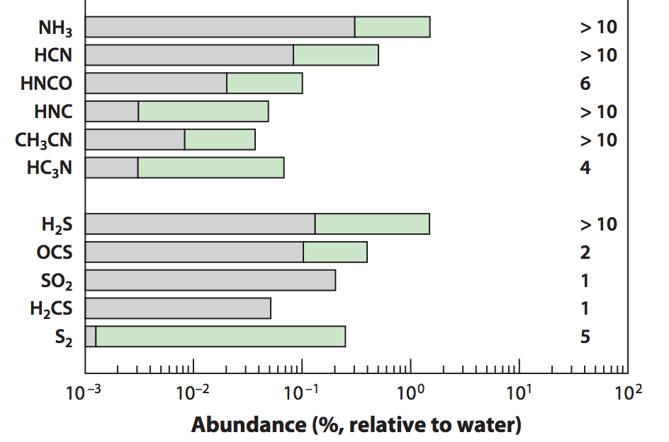
Nitrogen is important!
Add nitrogen-bearing molecules – nitrogen highly abundant in the Solar System and in disks and primarily found as N₂
Some N present in the form of NH₃
=> Use the median and maximum NH₃ abundances observed in protostellar cores from Spitzer c2d Legacy ice survey (Oberg et al. 2008, Oberg et al. 2011, etc.)
Mumma&Charnley(2011)
Notes:
Separate in two slides
Mention NH3 most abundant nitrogen carrier, bot low percentage of total N abundance => the rest in N2
Ice spectra or table
Show desorption curves from Edith’s paper

Slide 72
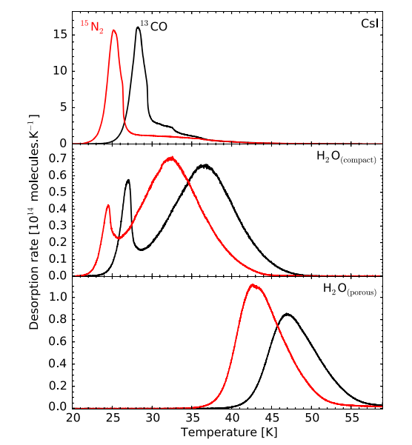
Ice Morphology
The binding energies of N₂ varies by a factor of ~1.7 depending on whether N2 is pure or water dominated ice
Fayolle+16

Slide 73
N/O ratios in static disks: highly enhanced gas N/O compared to the average value
Piso, Pegues, Oberg (2016)
Notes:
1) Focus on NH3 abundance, even with max NH3 still have enhanced N/O; block out bottom 2 panels first to talk about N/O

Slide 74
Disk dynamics and ice morphology may change the N₂ snowline locations by a factor of 7!
N₂ snowlines span 11-79 AU!
Piso, Pegues, Oberg (2016)
Notes:
Split in 2 slides; talk about N/O, then next slide say the same holds true for C/O

Slide 75
Takeaway point 2: Gas phase N/O ratios are highly enhanced throughout most of the disk compared to the average value, and more enhanced than the C/O ratio
Takeaway point 3: The locations of the CO and N₂ snowlines are highly uncertain and can span several tens of AU due to disk dynamics and ice morphology => observations are KEY

Slide 76
NEXT STEPS
Henning&Semenov (2013)

Slide 77
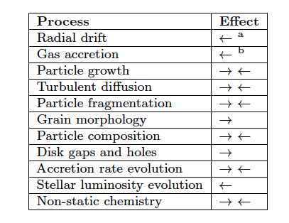
Additional chemical and dynamical processes to be explored
Piso, Oberg, Birnstiel, Murray-Clay (2015)
Piso+15

Slide 78
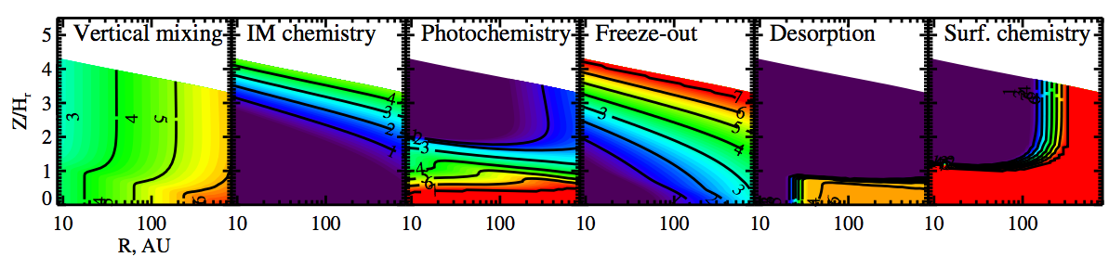
Chemistry and Dynamics need to be coupled
Semenov & Wiebe (2011)

Slide 79
Fundamental Questions
Where in the disk can giant planets form?
Piso et al. (2014)
Piso et al. (2015a)
2. What compositions will the formed giant planets have obtained?
Piso et al. (2015b)
Piso et al. (2016)
Notes:
----- Meeting Notes (4/22/16 11:46) -----
-add papers to last slide

Slide 81
Radial drift affects snowline location
Piso, Oberg, Birnstiel, Murray-Clay (2015)

Slide 82
The desorption distance for transition disks agrees with observations
Piso, Oberg, Birnstiel, Murray-Clay (2015)
Notes:
Cite TWHya paper

Slide 83
Private defense
Show EOS plots
Show final vs initial distance plots
Show fractional mass vs distance/time plots?
Discuss time-dependent C/N/O ratios; show plot for steady state disk if it exists; show equations on how to further expand model for evolving disk

Slide 84
Core accretion sketches and intro from previous talks
Summary of model assumptions
Have delad plots
Show result for polytropic EOS, then realistic EOS, then grain growth; either show plot for grain growth with coagulation or mention that coagulation will significantly decrease Mcrit
Takeaway point: Mcrit is highly dependent on disk location and properties, and may be as low as 1 ME; have Hr 8799 plot again

Slide 85
The Role of Disk Dynamics and Ice Morphology for Snowlines and the C/N/O Ratios
Restate that disk compositions regulat planet compositions; show image of planet accreting disk material
Introductory slides with disk processes, volatile detections in disk, CO snowline, WASP 12 b C/O “detection” and show show a picture of JWST; put disk cartoon later, C/O theoretical model
Introduce the idea of Oberg+11 and show plot
We expand this model by… introductory drift slide and gas accretion slide
Show timescales plot?
Show C/O plot from Paper I
Lead with ice morphology for CO; show Edith’s plot, then C/O plot; at the end mentuon that CH4 doesn’t really matter; then go to nitrogen
But, other volatile to consider besides H2O, CO2, CO if we want to better constrain disk/planet compositions; i.e. nitrogen carriers; at the end mentuon that CH4 doesn’t really matter
Show top part of snowlines plot
Explain that nitrogen is abundant in the solar system and why it is primarily N2 (show e.g. comet abundance plot and Karin’s 2011 paper); N2 highly volatile hence N/O ratio may be more enhanced than C/O; moreover, there’s also some NH3
Snow N/O static disk plot and mention high enhancement
Snowlines are also highly dependent on ice morphology; show plot from Edith’s paper
Show N/O ratio plot (in stages) to demonstrate how disk dynamics and ice morphology affect snowline locations
Takeaway point 1: N/O ratio enhanced throughout most of the disk, more enhanced than C/O; thus could be used to a trace a planet’s formation origin
Takeaway point 2: CO and N2 snowline locations highly uncertain and can span several tens of AU due to disk dynamics and ice morphology; need observations

